Slide 1
PaNOSC Portal Architecture
16th June, 2020
Authors: J. Hall (ILL), S. Caunt (ILL), W. Turner (ILL)

Slide 2
Overview
What is the PaNOSC Portal?
Common analysis services goals
Portal workflow
Challenges
Architecture
First iteration
Facility deployment
Status and Roadmap

Slide 3
What is the PaNOSC Portal?
The objective of this work package is to make data analysis services available through cloud hosted services and on the EOSC.
Build on experience and user feedback from VISA and CalipsoPlus
Simplify access to scientific software and tools
Promote collaborative and reproducible scientific analysis
Development of a common remote analysis application deployed at each site.
Provide Remote Desktops and Jupyter Notebooks
FAIR access to scientific data (public and embargoed)
Each facility implements a connector providing access to their compute and data infrastructure
Provide a common API to manage cloud resources on existing compute infrastructure.
A user will be able to select any facility and start remotely analysing their data via a single interface
Tie into services provided by other work packages
FAIR Data API (WP3)
AAI / data access and transfer (WP6)
Learning resources (WP8)

Slide 4
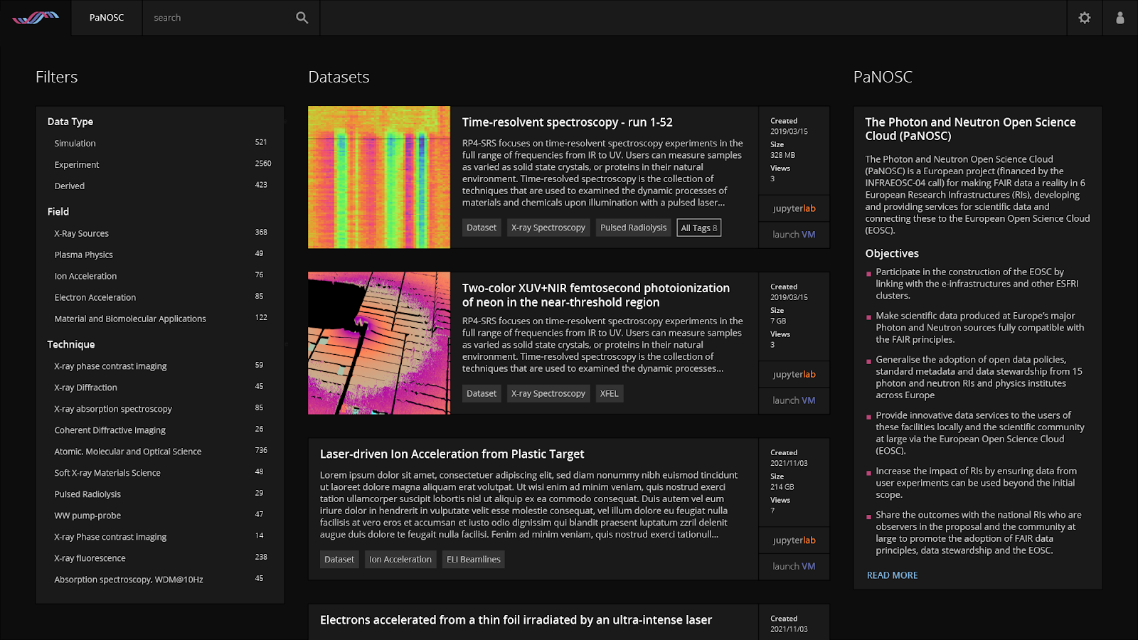
What is the PaNOSC Portal?
Image provided by J. Grosz (ELI)

Slide 5
Common analysis services goals
Provides seamless access to data and remote analysis tools
Common user interface and experience
Searching user data and open data across all facilities
Create a cloud resource for a selected dataset
Tailored to the data analysis requirements
Configurable environments
Collaborating on analysis and sharing the results
Common workflows for analysing well defined datasets
Sharing Remote Desktop sessions and Jupyter Notebook
Facilitating reproducability
Quotas to manage the distribution of cloud resources
Common authentication using UmbrellaID

Slide 6





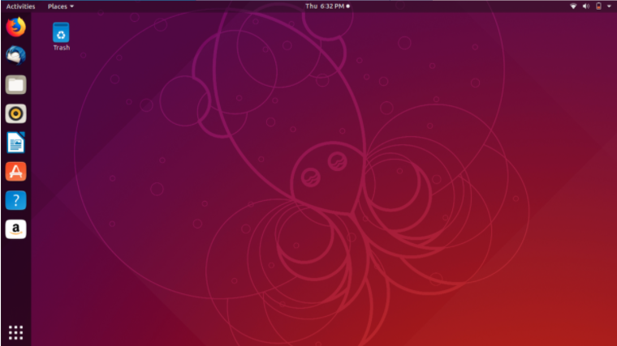
Portal Workflow
WP6
Login to portal
WP3
Find and select data to analyse
Is analysis already in progress?
yes
no
Can I collaborate?
Provision compute resources
no
Connect to the analysis environment and analyse data
yes
Save analysis results

Slide 7

Challenges
Each facility has different infrastructure, services and needs
Data analysis survey carried out to get a better understanding
Use cases and specification validated by all partners
Distributed development across facilities
Different skill sets and availabilities
Different levels of maturity of existing solutions
Data policy, DOIs, Remote Desktops, Jupyter Notebooks, NeXUS etc.
Deployment
Different levels of experience

Slide 8
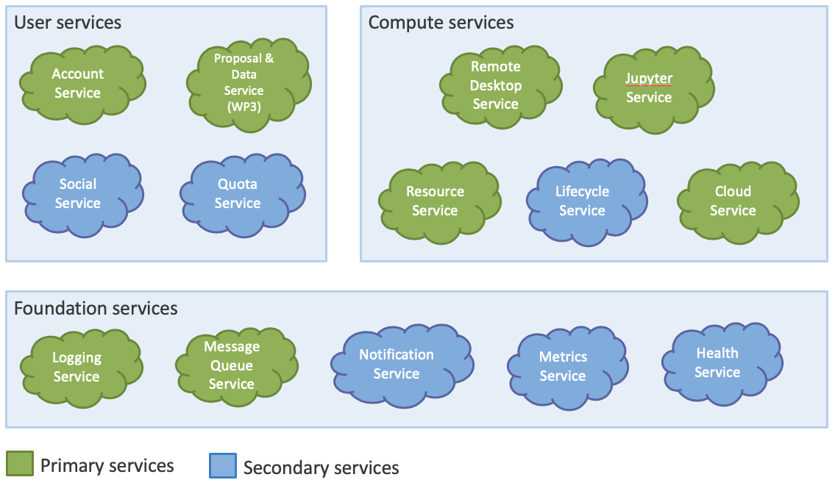
Architecture
Built on a micro-service architecture
Easy to have multiple developers developing separate functionalities (shared responsibilities)
Well-defined API for each module/service
Enable site-specific implementations
Less dependence on a single language/technology (allows flexibility)
Identified core and secondary services
Analysis of the use cases and feature prioritisation
Iterative development
Enables quick feedback
Reactive to changes
Documentation publically available

Slide 9
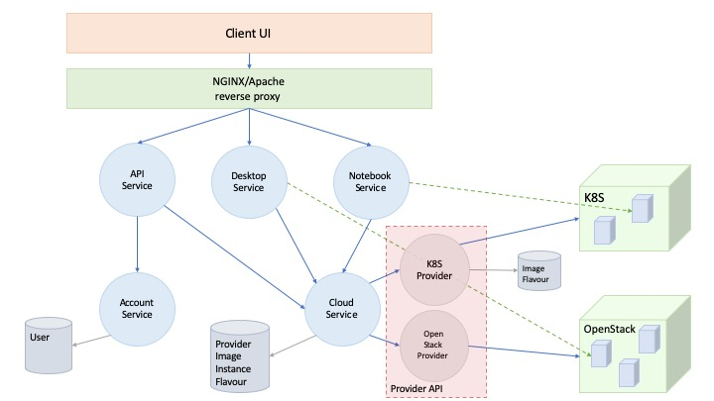
First iteration
Management of compute resources
Implementation of Kubernetes cloud provider.
Validation of architecture core services
Deployed at partner sites
User authentication (OpenID connect)
Obtain feedback
Encountered problems / constraints / edge cases
Micro-services developing use NodeJS / Java
All source code is Open Source and made available on GitHub.

Slide 10


Facility Deployment
Automated the deployment of the portal
Use Kubernetes to manage the orchestration of the micro-services
Packaged as HELM charts
Configurable for site specific needs
Easy to upgrade
First stable production release
Open sourced on GitHub
Demo version available
Single command, no configuration
Dummy environment
Allows for simple testing of latest features

Slide 11

Status and Roadmap
First development iteration completed
Validated the architecture
Feedback from partners
Next stage is to integrate the frontend and backend developments
Looking at integrating
FAIR Data API of WP3
Data Access from WP6
Development of other micro-services
SLURM and OpenStack Cloud Providers (priority)
Messaging / Notification service
Quota service
Metrics service
Demonstrator deployed at each site: November 2021
Obtain user feedback after beta testing / validation: May 2022
Deployment onto EOSC: November 2022

Slide 12
Thank you

